Slide 1

CAPSTONE PROJECT
NORTHWIND TRADERS SALES ANALYSIS

Slide 2
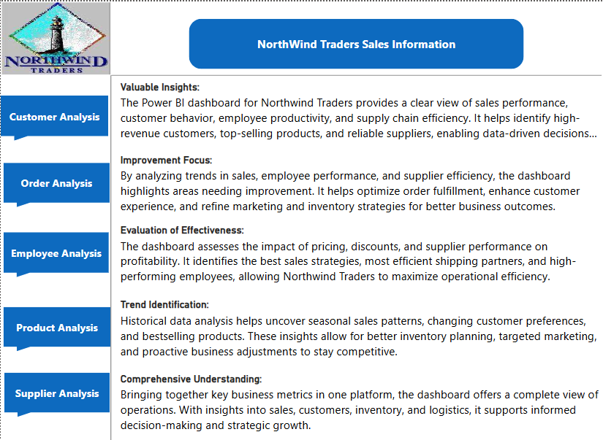

Slide 3
Objective:
The objective of this Power BI report is to provide Northwind Traders with a visually appealing and interactive dashboard that enables data-driven decision-making. By analyzing sales trends, customer behavior, inventory performance, and employee efficiency, the report helps stakeholders identify key business drivers. The insights derived from this report will assist in optimizing operations, improving customer retention, and enhancing profitability. It ensures that decision-makers have access to real-time and historical data for strategic planning. The ultimate goal is to drive growth and maintain a competitive edge in the wholesale market.
Analysis Scope:
The analysis scope includes data from multiple tables within the Northwind database, covering customers, employees, orders, products, suppliers, and shippers. It involves examining customer segmentation, sales trends, inventory levels, and employee performance using SQL and Power BI. Various data visualization techniques, including heatmaps, bar charts, line charts, and scatter plots, are employed to uncover patterns. The report also focuses on correlating different business metrics to identify trends and anomalies. Interactive filters and drill-downs enhance data exploration for better decision-making.
Goal:
The goal of this project is to develop a comprehensive Power BI dashboard that offers actionable insights into Northwind Traders' business operations. It aims to enhance the understanding of sales performance, customer behavior, and workforce efficiency. By leveraging interactive visualizations, stakeholders can make informed decisions to optimize revenue, improve supply chain management, and boost employee productivity. The dashboard will serve as a strategic tool for monitoring key performance indicators (KPIs). Ultimately, it will help the company maintain a strong position in the market.

Slide 4
Insights and Recommendations:
The analysis provides valuable insights into sales performance, customer demographics, and employee efficiency. Key findings may include high-performing products, top customer segments, and seasonal sales trends. Recommendations can involve optimizing inventory management, improving customer engagement strategies, and enhancing employee training programs. Identifying supplier performance variations can help streamline procurement processes. These insights empower Northwind Traders to make data-driven decisions that enhance profitability and operational efficiency.
Report and Presentation:
The final report will consolidate all findings into a structured document that includes visualizations, key insights, and recommendations. It will be formatted for clarity, making it easy for stakeholders to interpret complex data. The presentation will highlight major trends, data-driven conclusions, and actionable strategies. Visual elements such as charts, maps, and infographics will be used to enhance comprehension. This structured approach ensures effective communication of findings to decision-makers.
Power BI Dashboard:
The Power BI dashboard serves as the central visualization tool, offering interactive and real-time insights into Northwind Traders’ operations. It includes key metrics such as total sales, order trends, customer distribution, and employee performance. Users can apply filters to explore specific segments, products, or time periods for deeper analysis. The dashboard enables quick decision-making by presenting complex data in an easy-to-understand format. By integrating multiple datasets, it provides a holistic view of the business, aiding in strategic planning and performance monitoring.

Slide 5
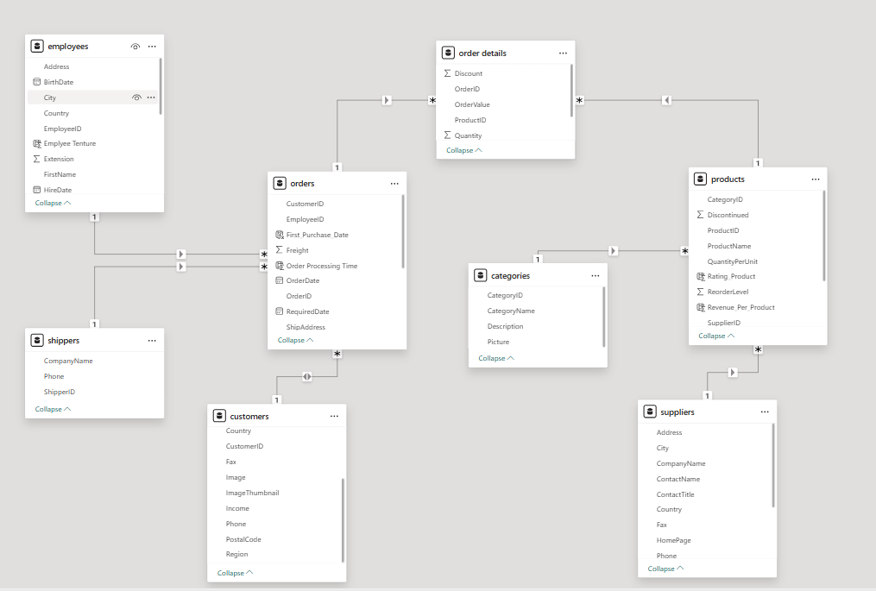
ER DIAGRAM

Slide 6
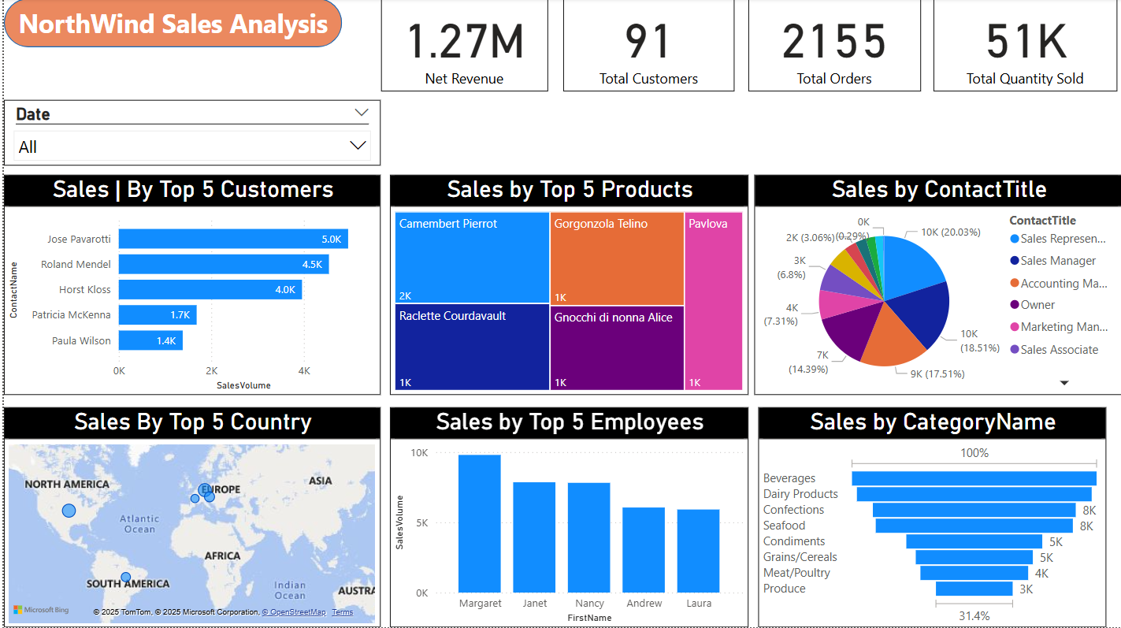
POWERBI PROBLEM STATEMENTS Overview

Slide 7
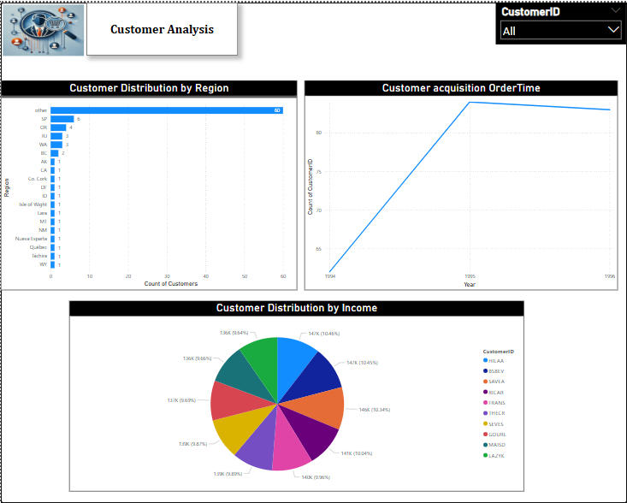

Slide 8
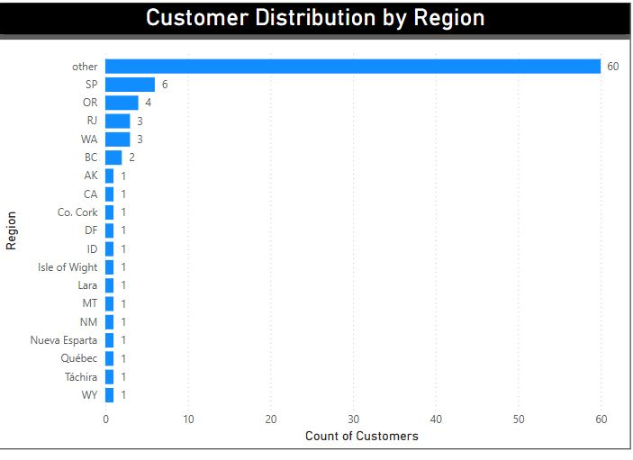
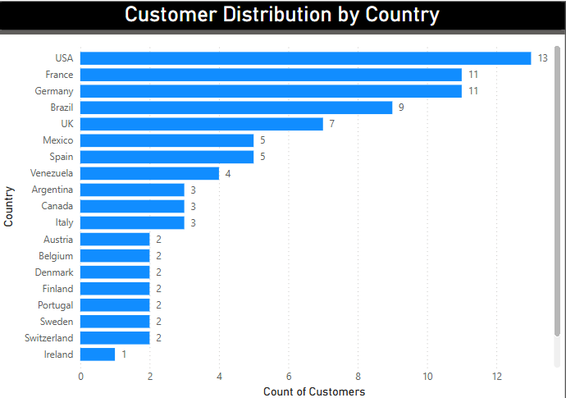
How does customer distribution vary across different regions?
The chart shows that most customers (60) fall under the "Other" category, indicating a high concentration in unspecified regions. São Paulo (SP) has the next highest count (6), followed by Oregon (4), with other regions having very few customers. This suggests a fragmented customer base, and further analysis of the "Other" category could help identify growth opportunities in specific regions. Here in the given Dataset they did not give region names for most of the rows that’s why I have taken other instead of empty region.
So for getting correct output I took country name and I found Customer Distribution by Country Name(like the second chart). The chart shows that most customers(13) fall under USA and France and Germany has the next highest count(11) and Ireland has less number of Customers.

Slide 9
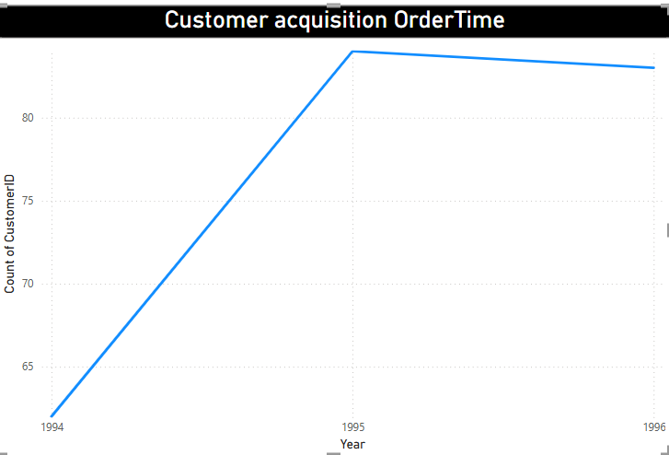
What is the trend in customer acquisition over time?
The chart indicates an increase in customer acquisition from 1994 to 1995, followed by a slight decline in 1996. The steep rise in 1995 suggests a strong growth phase, possibly due to successful business strategies or market expansion. However, the slight dip in 1996 may indicate retention challenges or market saturation. Further analysis is needed to understand the reasons behind these trends and identify opportunities for sustained growth.

Slide 10
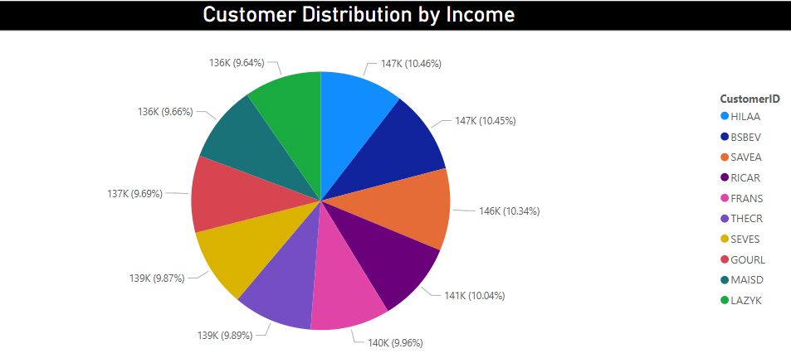
Can we visualize the distribution of customer demographic such income
The pie chart illustrates the distribution of customers based on income, with income levels ranging from 136K to 147K, each holding a fairly equal share. The variation among income groups is minimal, suggesting a relatively uniform customer base in terms of earnings. This insight can help in targeting marketing strategies and tailoring product offerings based on income segments. Further demographic analysis, including age and gender, can provide deeper insights into customer preferences.
And here the highest income has been recorded for HILAA with 147k and Least with LAZYK with 136k

Slide 11
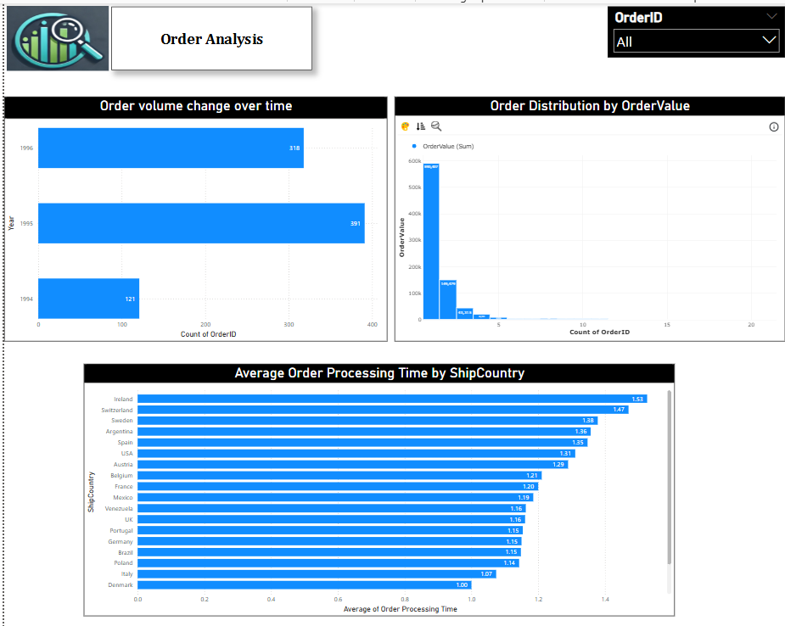

Slide 12
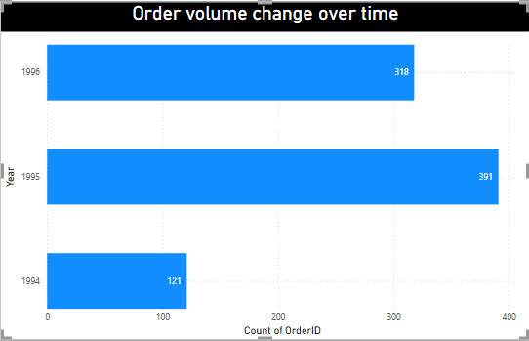
How does order volume change over time?
The chart shows a clear upward trend in order volume from 1994 to 1995, with orders increasing significantly from 121 to 391. However, in 1996, there is a decline to 318 orders, suggesting a potential drop in demand or operational changes. This insight can help in identifying factors influencing sales fluctuations, such as seasonality, marketing efforts, or supply chain issues. Further analysis can determine the reasons behind the 1996 decline and opportunities for growth.

Slide 13
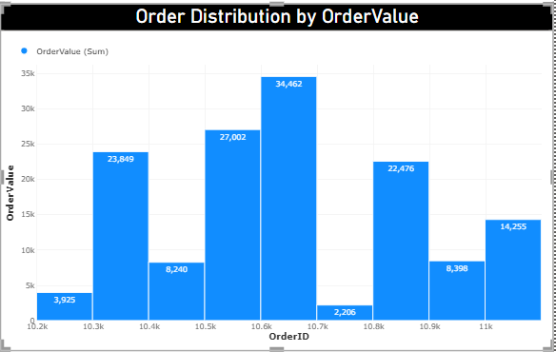
What is the distribution of order values?
The order value distribution, as shown in the chart, exhibits significant variation across different Order IDs. The highest order value is 34,462, indicating a peak in sales for a specific order. Other notable high-value orders include 27,002, 23,849, and 22,476, showing consistent large transactions. However, there are also relatively low order values, with the lowest being 2,206, followed by 3,925 and 8,240, highlighting fluctuations in purchasing patterns. This distribution suggests that while some orders contribute significantly to total revenue, others remain relatively small. Such insights can help in identifying high-value orders, optimizing pricing strategies, and improving sales forecasting.

Slide 14
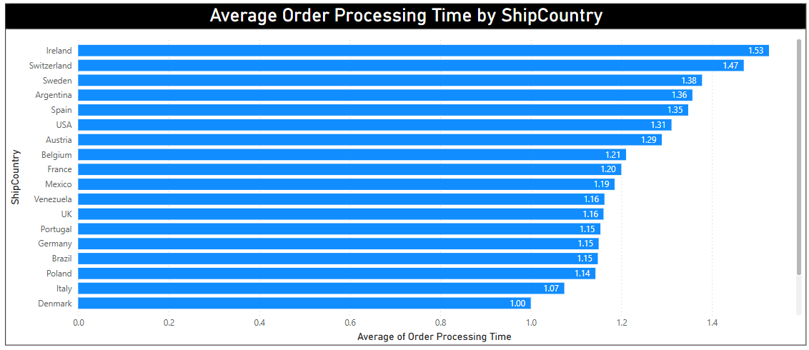
Can we visualize the average order processing time?
The bar chart illustrates the average order processing time across different shipping countries. Ireland (1.53 Weeks), Switzerland (1.47 Weeks), and Sweden (1.38 Weeks) have the longest processing times, while Denmark (1.00 days), Italy (1.07 Weeks), and Poland (1.14 Weeks) are the most efficient. Most countries fall within the 1.10 - 1.35 Weeks range, indicating relatively consistent processing times. The variations may be due to logistics efficiency, shipping infrastructure, or operational factors. To enhance efficiency, it is crucial to identify the causes of delays in high-processing-time regions and optimize logistics accordingly.

Slide 15
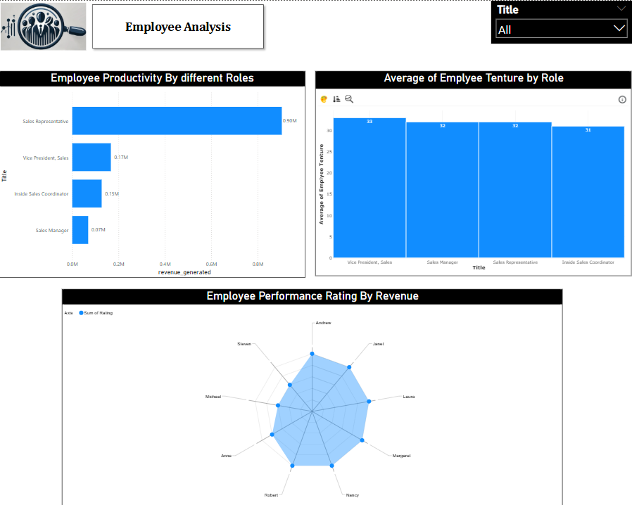

Slide 16
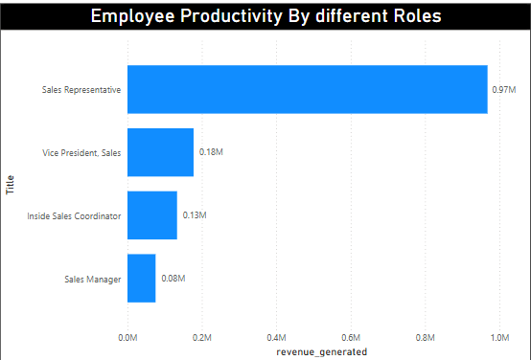
How does employee productivity vary across different job roles?
The chart illustrates employee productivity across different job roles based on revenue generated. Sales Representatives exhibit the highest productivity, generating approximately 0.97M in revenue, significantly outperforming other roles. The Vice President of Sales follows with 0.18M, while Inside Sales Coordinators and Sales Managers contribute 0.13M and 0.08M, respectively. This suggests that Sales Representatives play a crucial role in driving revenue, whereas managerial and coordination roles contribute comparatively less.

Slide 17
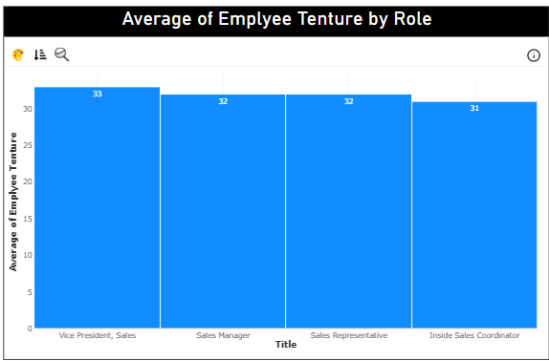
What is the distribution of employee tenure?
The chart presents the distribution of employee tenure across different roles, indicating that tenure remains relatively consistent across job titles. The Vice President of Sales has the highest average tenure at 33, followed closely by Sales Managers and Sales Representatives at 32, while Inside Sales Coordinators have the lowest at 31. This suggests that employees, regardless of their role, tend to have a stable tenure within the organization, with minimal variation across positions.

Slide 18
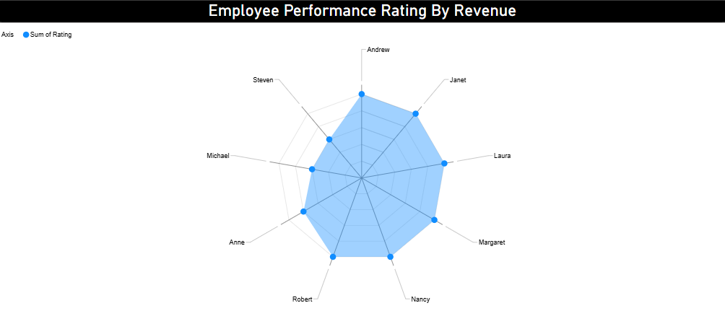
Can we visualize employee performance ratings?
The radar chart effectively visualizes employee performance ratings by revenue, highlighting variations among individuals. Employees like Andrew, Janet, Laura, Margaret, Nancy, Robert appear to have higher ratings, while others, Anne got 4 rating and Michael and Steeven got 3 ratings. The concentration of ratings between 4 and 5 suggests consistently strong performance across the team, with some employees excelling more than others. This visualization helps in identifying top performers and areas where improvement may be needed.

Slide 19
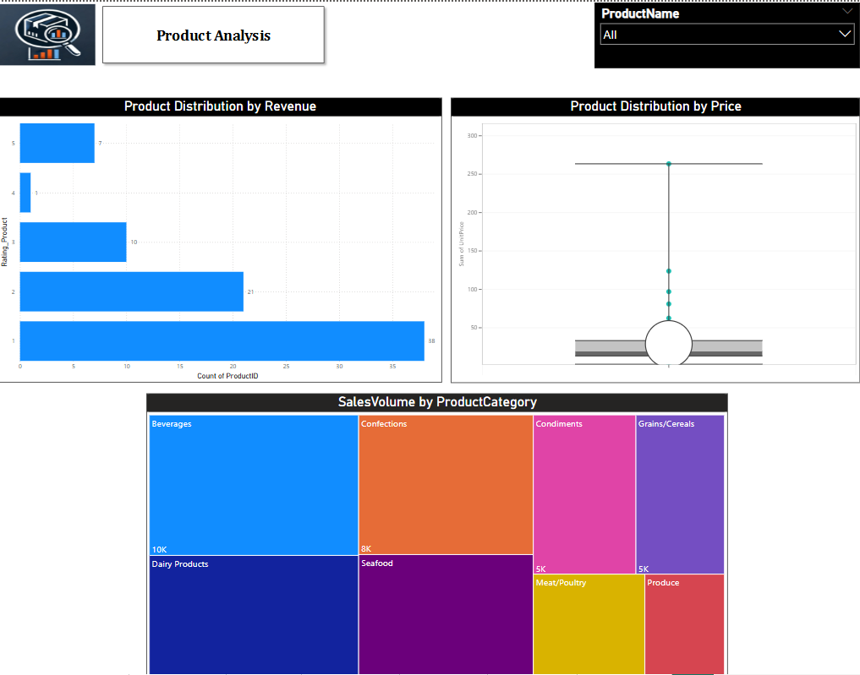

Slide 20
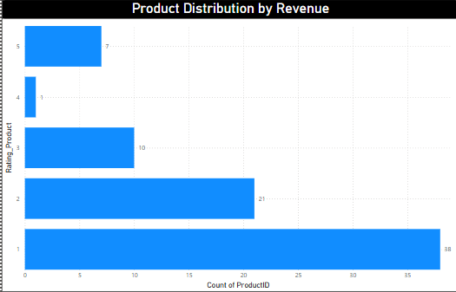
What is the distribution of product ratings?
The product distribution chart, based on revenue-based rating conditions, shows that most products fall into the lower revenue categories. Specifically, 38 products have a rating of 1, meaning their revenue per product is below $10,000. Similarly, 21 products are rated 2, indicating revenue between $10,000 and $20,000. The number of products decreases as the revenue threshold increases, with 10 products rated 3 ($20,000–$30,000), 1 products rated 4 ($30,000–$40,000), and only 7 products achieving the highest rating of 5 (above $40,000). This distribution suggests that a significant portion of products generate relatively low revenue, while only a few achieve high performance. It may be beneficial to investigate factors affecting product sales and explore strategies to boost revenue across more products.

Slide 21
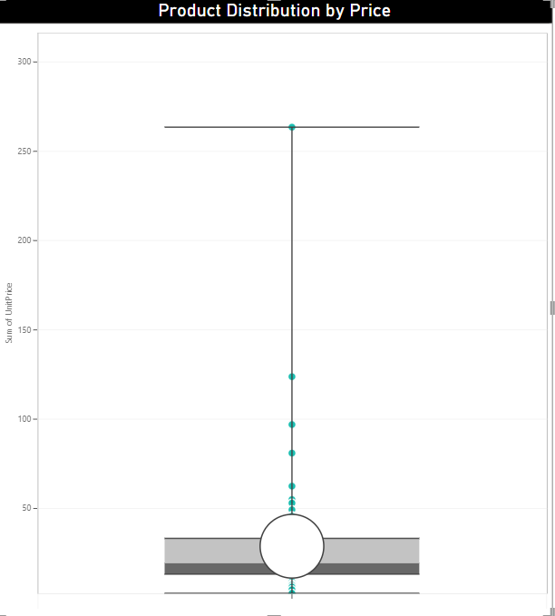
Can we visualize the pricing distribution of products using a box plot
A box plot is an effective way to visualize the pricing distribution of products, as shown in the given chart. The majority of product prices are concentrated within a lower range, indicated by the dense cluster in the box. However, there are significant outliers, such as CôtedeBlaye (263.5) and Thüringer Rostbratwurst (127.9), which stand far above the main distribution. The least-priced product, Geitost (2.5), falls within the lower range. The long upper whisker in the box plot suggests that while most products are priced relatively low, a few high-priced items significantly extend the price range. This indicates a right-skewed distribution, where premium-priced products create substantial variance in pricing.

Slide 22
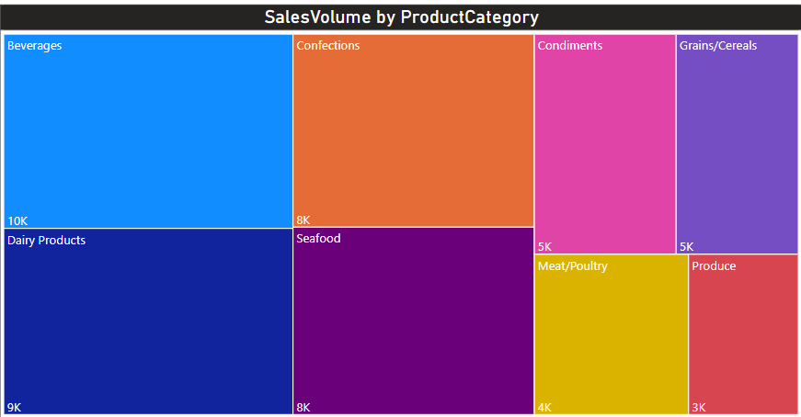
How does the sales volume vary across different product categories?
The sales volume varies significantly across different product categories. Beverages lead with the highest sales volume at 10K, followed by Dairy Products (9K) and Confections (8K), indicating strong consumer demand in these categories. Seafood also has a notable sales volume of 8K, while Condiments and Grains/Cereals have moderate sales at 5K each. However, Meat/Poultry (4K) and Produce (3K) show the lowest sales volumes, suggesting potential areas for improvement through targeted marketing or inventory optimization. This distribution highlights the need to focus on high-performing categories while strategizing growth for lower-selling products.

Slide 23
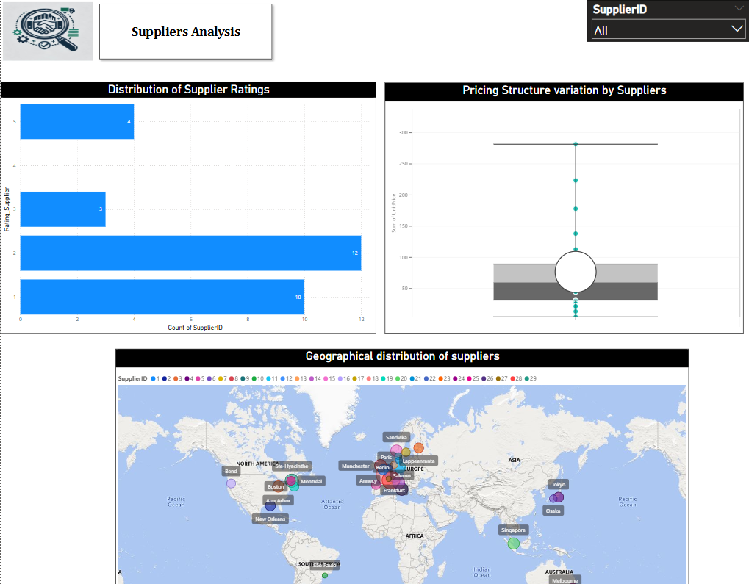

Slide 24
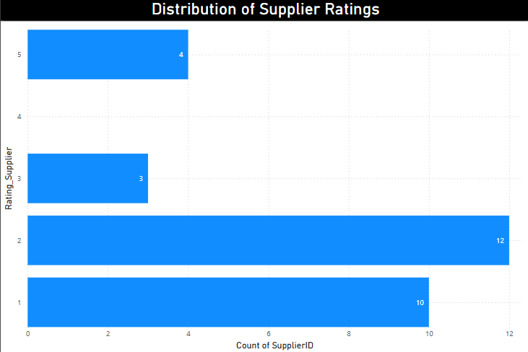
What is the distribution of supplier ratings?
The distribution of supplier ratings based on revenue generated, as shown in the chart, indicates that the majority of suppliers have received lower ratings. Rating 2(greater than 25000 revenue and below 50000 revenue generated) has the highest count with 12 suppliers, followed by rating 1 with 10 suppliers, showing a concentration in the lower rating range. In contrast, higher ratings are less frequent, with only 4 suppliers each receiving ratings of 3 and 5, and no suppliers rated 4. This suggests that supplier performance is skewed toward the lower end, indicating potential concerns with supplier quality or consistency. It may be beneficial to investigate the factors contributing to these lower ratings and take steps to improve supplier performance.

Slide 25
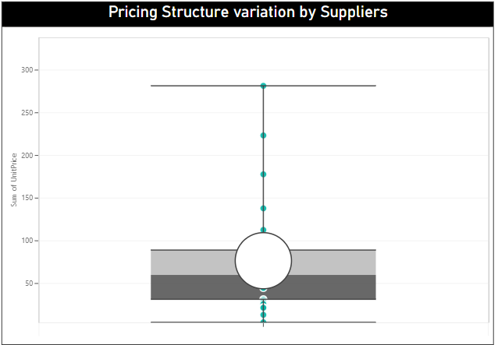
How does the pricing structure vary across different suppliers?
The pricing structure across different suppliers, as depicted in the box plot, shows significant variation. Supplier ID 12 has the highest sum of unit prices at 223.39, followed by Supplier ID 7 with 177.85, indicating that these suppliers provide higher-priced products. On the other hand, Supplier ID 10 has the lowest sum of unit prices at 4.50, highlighting a substantial disparity in pricing among suppliers. The presence of outliers in the chart suggests that certain suppliers offer exceptionally high-priced products, while most suppliers have pricing concentrated within a lower and more consistent range. This variation in pricing could be due to differences in product categories, quality, or market positioning among suppliers.

Slide 26
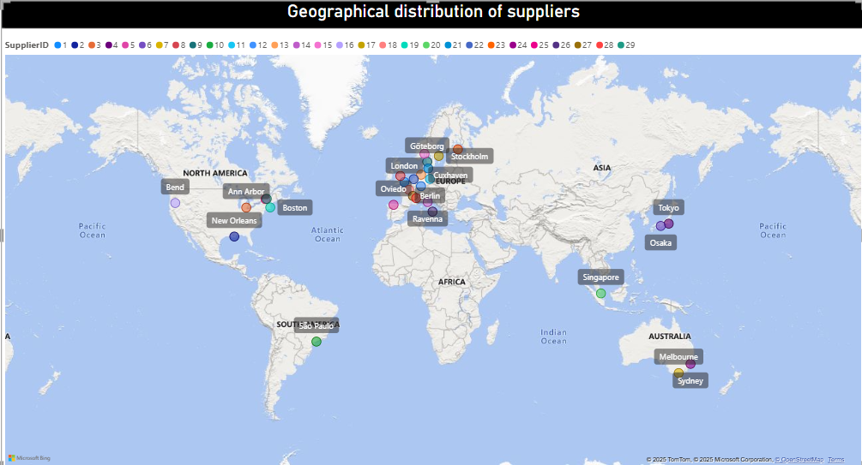
Can we visualize the geographical distribution of suppliers using a map or bubble chart?
The geographical distribution of suppliers, as visualized on the map, provides valuable insights into their locations and revenue contributions. Supplier ID 18 from France has the highest revenue of 163,135, followed closely by Supplier ID 12 from Germany with 155,956, revenue indicating strong market presence and sales performance in these regions. On the other hand, Supplier ID 10 from Brazil, with the lowest revenue of 4,286.5, suggests limited business activity. The distribution highlights a diverse supplier network spanning North America, Europe, Asia, Australia, and South America, with key hubs in cities like Berlin, London, Tokyo, and São Paulo. This visualization is useful for identifying high-performing regions, optimizing supplier partnerships, and strategizing future business expansion.

Slide 27
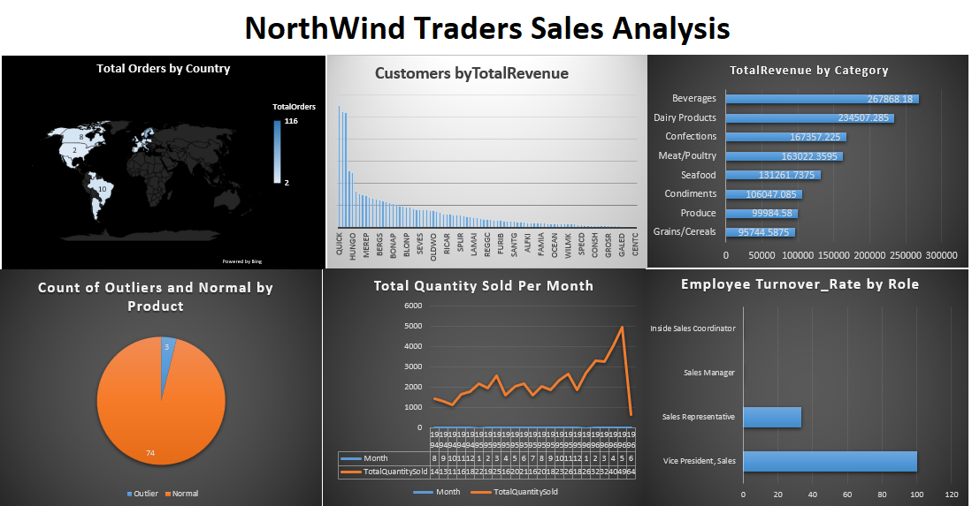
EDA Problem statements

Slide 28
What are the key factors influencing customer retention or loyalty based on the dataset?
The chart visualizes the relationship between total orders and total discounts received by different customers, highlighting customer retention trends. The Orange bars represent total orders, while the gray bars indicate total discounts, showing how frequently customers purchase and how much discount they utilize. Customers like SAVEA (120 orders, low discount) and HUNGO (100 orders, low discount) demonstrate strong retention with minimal discounts, suggesting they value product quality, availability, and service over price reductions. Meanwhile, WELLI (40+ orders, higher discount) and RANCH (low orders, high discount) indicate price-sensitive buyers who may need promotions to stay engaged. Additionally, GALED and CHOPS (low orders, minimal discount) suggest one-time buyers who may require targeted retention strategies. Beyond discounts, factors like delivery speed, brand reputation, customer service, and personalized loyalty programs also influence retention. Since discounts alone do not guarantee loyalty, Northwind Traders should optimize these aspects to build long-term customer relationships and enhance business sustainability.

Slide 29
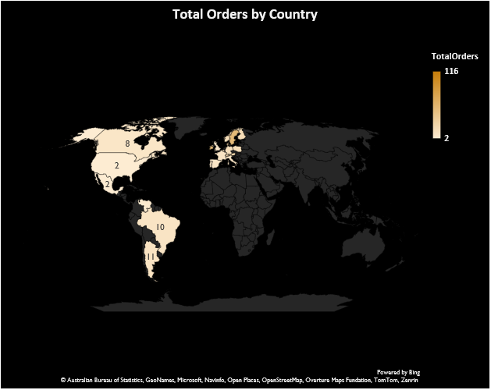
How do customer preferences vary based on their location or demographics?
The chart reveals significant variations in customer preferences based on location. Boise, USA, recorded the highest number of orders (116), making it the top-performing region, while Walla Walla, USA, had the lowest (2 orders). Germany generated the highest revenue (110,277.30), with Cunewalde City as a major contributor, whereas Mexico City had the lowest revenue (100.8). These insights indicate that customer behavior is influenced by location, order value, and product demand. By analyzing product preferences, order value, and purchase quantity across regions, businesses can better understand customer needs. Identifying these trends allows for more effective marketing, inventory planning, and sales strategies. Tailoring offerings based on location-specific demands can improve customer retention and overall business growth.

Slide 30
Are there any interesting patterns or clusters in customer behavior that can be visualized to identify potential market segments?
The Customer and Average Order Value chart shows two key segments: high-value, low-frequency buyers (e.g., QUICK, SAVEA) and low-value, high-frequency buyers (e.g., CENTC, GALED). High AOV customers make bulk purchases, while others place smaller, frequent orders. This segmentation helps in designing targeted marketing strategies. Businesses can offer personalized incentives to maximize revenue from each group.
The Total Orders vs. Average Order Value chart highlights an inverse relationship—more orders generally mean lower AOV. Frequent buyers likely purchase low-cost products, while bulk buyers make larger transactions. Businesses can offer bulk discounts to high-AOV customers and cross-sell or bundle products to increase revenue from low-AOV buyers. Identifying key drivers like discounts and product preferences can further optimize sales strategies.
High-value, low-frequency buyers and low-value, high-frequency buyers exhibit distinct purchasing behaviors, allowing businesses to optimize revenue through targeted discounts, bundling, and personalized marketing strategies.

Slide 31
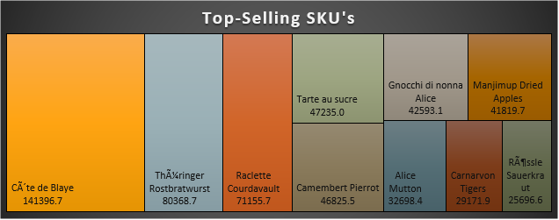
Are there any specific product categories or SKUs that contribute significantly to order revenue?
The analysis reveals that the "Beverages" category contributes the highest revenue (267,868.18), while "Grains/Cereals" generates the least (95,744.58). This indicates a significant variance in revenue across different product categories, emphasizing the importance of high-performing categories in driving overall sales.
At the SKU level, "CÃ´te de Blaye" is the top-selling product with a revenue of 141,396.73, while "RÃ¤ssle Sauerkraut" records the lowest among the top 10 (25,696). Identifying these high-revenue products helps optimize stock availability, meet demand, and refine pricing strategies for profitability.

Slide 32
Are there any correlations between order size and customer demographics or product categories?
The analysis indicates a positive correlation between average order size and total revenue, with larger orders contributing significantly to revenue growth. Certain cities, such as Portland and Buenos Aires, exhibit higher average order sizes alongside substantial total revenue, suggesting that bulk purchasing plays a key role in driving sales. However, there are exceptions where revenue does not increase proportionally with order size, highlighting the need for further analysis on pricing strategies and customer preferences.
Regarding product categories, the data shows fluctuations in the relationship between average order size and total revenue. Beverages and dairy products generate the highest revenue despite varying order sizes, suggesting that product demand and pricing strategies significantly impact revenue. Some categories, such as condiments and grains/cereals, contribute less to overall revenue despite higher order sizes, indicating that order size alone is not the sole factor influencing profitability.

Slide 33
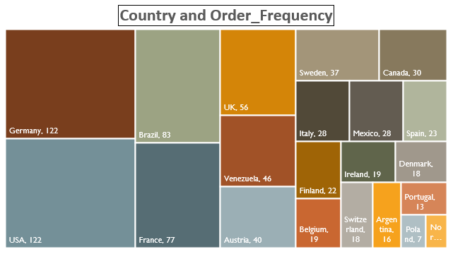
How does order frequency vary across different customer segments?
The bar chart shows that a few customers place the majority of orders, with SAVEA, HILAA, and FRANK being the most frequent buyers. The order frequency decreases significantly for other customers, indicating that a small group of high-value customers contributes heavily to sales. These customers can be targeted for loyalty programs or exclusive offers to encourage repeat purchases.
The Treemap highlights order frequency by country, with Germany and the USA leading at 122 orders each, followed by Brazil (83) and France (77). Countries like the UK, Venezuela, and Austria also contribute significantly, while Poland and Norway have much lower order volumes. This suggests that businesses should focus marketing efforts on top-performing regions while exploring ways to increase engagement in lower-order regions through localized promotions or better distribution.
Overall, the analysis confirms that a few key customers and countries drive most of the sales. Businesses should prioritize these segments with tailored marketing strategies and customer retention efforts while identifying opportunities to boost engagement in underperforming regions.

Slide 34
Are there any correlations between employee satisfaction levels and key performance indicators?
The line chart shows the relationship between employee tenure and total orders processed. The trend fluctuates significantly, with no clear upward or downward pattern, indicating that tenure alone may not directly correlate with order processing efficiency. Some employees with longer tenure handle a high volume of orders, while others show lower productivity, suggesting that other factors like job satisfaction, motivation, or workload distribution might be influencing performance.
To explore this further, additional factors like employee satisfaction scores, workload, and incentives should be included in the analysis. A scatter plot comparing satisfaction levels with total orders could help identify whether happier employees tend to perform better. If a strong correlation exists, businesses can invest in improving workplace conditions to enhance productivity.

Slide 35
How does employee turnover vary across different departments or job roles?
The bar chart illustrates the variation in turnover rates across different job roles. The highest turnover is observed among Vice Presidents of Sales, followed by Sales Representatives, while other roles like Inside Sales Coordinators and Sales Managers show little to no turnover. This suggests that higher-level sales positions may experience greater pressure, responsibility, or dissatisfaction, leading to higher attrition.
This can help identify problem areas where intervention—such as better incentives, work-life balance initiatives, or career growth opportunities—may reduce turnover and improve employee retention.

Slide 36
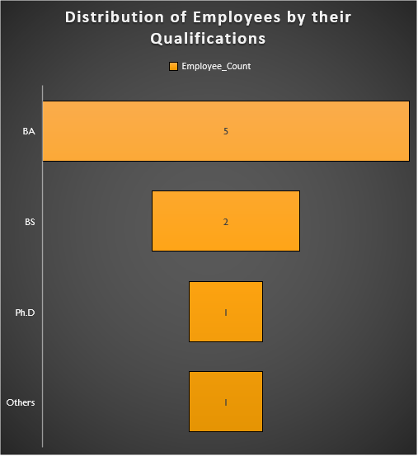
Can we identify any patterns or clusters in employee skill sets or qualifications through visualizations?
The funnel chart visually represents the distribution of employee qualifications. The largest segment consists of employees with a BA degree, followed by a smaller number with BS degrees, and an even fewer number with Ph.D. or other qualifications. The narrowing shape highlights the progressive decrease in employees as qualifications become more advanced.
This visualization helps in identifying trends in the workforce's educational background. It can be used for talent management by guiding hiring strategies, workforce planning, and training programs. If higher qualifications contribute to better performance, organizations can focus on upskilling existing employees or recruiting more specialized talent. Additionally, understanding this distribution helps in designing leadership development programs for employees with potential.

Slide 37
Are there any correlations between product attributes and sales performance?
The scatter plot shows a positive correlation between unit price and total revenue, indicating that higher-priced products generally contribute more to revenue. However, there are outliers, where some high-priced products generate exceptionally high revenue, while others underperform. Most sales are concentrated in the low to mid-price range (0-50 units), suggesting that affordable products drive the majority of revenue. The presence of a few high-revenue, high-priced items implies a demand for premium products. These insights can help optimize pricing strategies, inventory planning, and marketing efforts to maximize overall sales performance.

Slide 38
How does product demand fluctuate over different seasons or months?
The line chart indicates a gradual increase in product demand over time, with noticeable fluctuations across months. Demand appears to be seasonal, with periodic dips and peaks. The trend shows a steady rise in sales, peaking sharply towards the end before experiencing a sudden drop. This pattern suggests seasonal spikes in demand, possibly influenced by factors like holidays, promotions, or external market conditions. Businesses can leverage these insights to optimize inventory management, marketing campaigns, and production planning to align with high-demand periods while mitigating risks during lower sales months.

Slide 39
Can we identify any outliers or anomalies in product performance or sales using visualizations?
The visualization effectively identifies outliers in sales performance. The bar chart categorizes sales into "Normal" and "Outlier" groups, where normal sales account for 1,040,441.99, while outliers contribute 314,016.6—a significant deviation. The presence of outliers suggests unusual sales patterns, which could result from promotional events, bulk orders, stock clearance, or fraudulent activities. Investigating these anomalies further could help in refining sales forecasting, pricing strategies, and demand planning to ensure business stability and minimize risks associated with unexpected fluctuations.

Slide 40
Are there any correlations between supplier attributes (e.g., total orders) and performance metrics (e.g., on-time delivery)?
The scatter plot of total orders and on-time delivery rate suggests that there may be a weak or inconsistent correlation between supplier performance metrics. While some suppliers maintain high on-time delivery rates regardless of order volume, others exhibit a decline in performance as orders increase. This indicates that supplier attributes such as size, industry, and operational capacity may influence their ability to deliver on time. Larger suppliers with efficient logistics may handle higher order volumes without compromising delivery performance, whereas smaller or less optimized suppliers might struggle with scalability. Further analysis, including segmentation by location and industry, could provide deeper insights into patterns affecting supplier reliability and product quality.

Slide 41
How does supplier performance vary across different product categories or departments?
The supplier performance across different product categories varies significantly, as seen in the total orders for each supplier within various categories. Certain suppliers dominate specific categories, such as Specialty Biscuits in Confections (126 orders) and New England in Seafood (88 orders), indicating strong demand and likely reliability in fulfilling orders. Dairy products show consistent high performance across multiple suppliers, with Formaggi Fortini, Gai Pâturage, and Norske Meierier all having over 100 orders each. On the other hand, categories like Produce and Condiments have relatively lower total orders, suggesting either lower demand or potential inefficiencies in supplier fulfillment. These insights can help in optimizing supplier selection, renegotiating contracts, and focusing on high-performing suppliers to improve overall supply chain efficiency.

Slide 42
Can we identify any trends or patterns in supplier costs or pricing structures through visualizations?
The Supplier vs. AvgOrderPrice bar chart shows large differences in supplier pricing. Some suppliers, like Aux joyeux ecclésiastiques and G’day, Mate, have much higher average order prices, suggesting they offer premium or specialized products. Others, like Cooperativa de Quesos 'Las Cabras' and Leka Trading, have lower prices, likely focusing on bulk or commodity products. These price differences indicate that Northwind Traders could review supplier pricing strategies to reduce costs. Additionally, variations may be due to inconsistent discounting, making it important to analyze supplier contracts and pricing agreements.
The AvgOrderPrice by OrderDate chart shows seasonal pricing trends, with sharp price spikes in December 1995 and 1996, likely due to high holiday demand or bulk orders. Outside these peaks, prices remain stable with minor fluctuations. Northwind Traders can use this insight to adjust purchasing strategies, buy during off-peak periods, and negotiate better supplier contracts to manage seasonal price increases.

Slide 43
conclusion
The analysis of Northwind Traders sales data provides valuable insights into various aspects of business operations, including customer behaviour, sales trends, employee performance, inventory management, and supplier reliability. By leveraging data-driven decision-making, Northwind Traders can optimize its operations, improve efficiency, and enhance customer satisfaction.
The sales analysis of Northwind Traders highlights key areas for business improvement, including customer retention, sales trends, inventory management, and employee performance. Data-driven insights enable better decision-making, such as optimizing stock levels, refining marketing strategies, and improving supplier relationships. Identifying high-value customers and seasonal demand patterns helps boost sales and efficiency. Enhancing employee performance and supplier reliability ensures long-term growth and stability.

Slide 44
Thank you

